Slide 1
OpenGL Environment Ideas
Ajil Pappachan
L5 GMD

Slide 2
Idea 1 - City

Slide 3
Layout and Concept
A flat plane as ground
Cuboids of different sizes as buildings
A Sphere in the distance as the sun

Slide 4
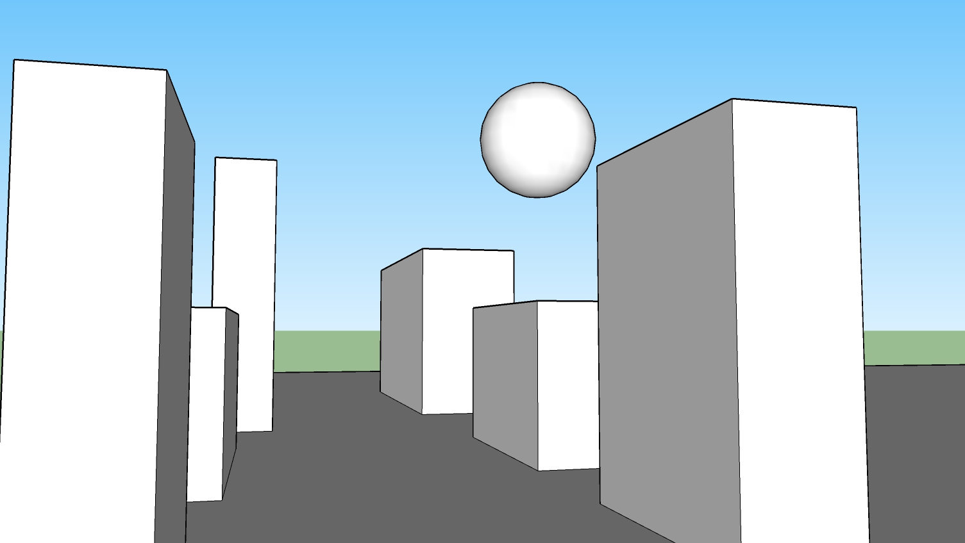
Mock-Up

Slide 5
Idea 2 - Meadow

Slide 6
Layout and Concept
A flat plane as ground
Triangles as Grass
A cuboid in the back as a stage

Slide 7
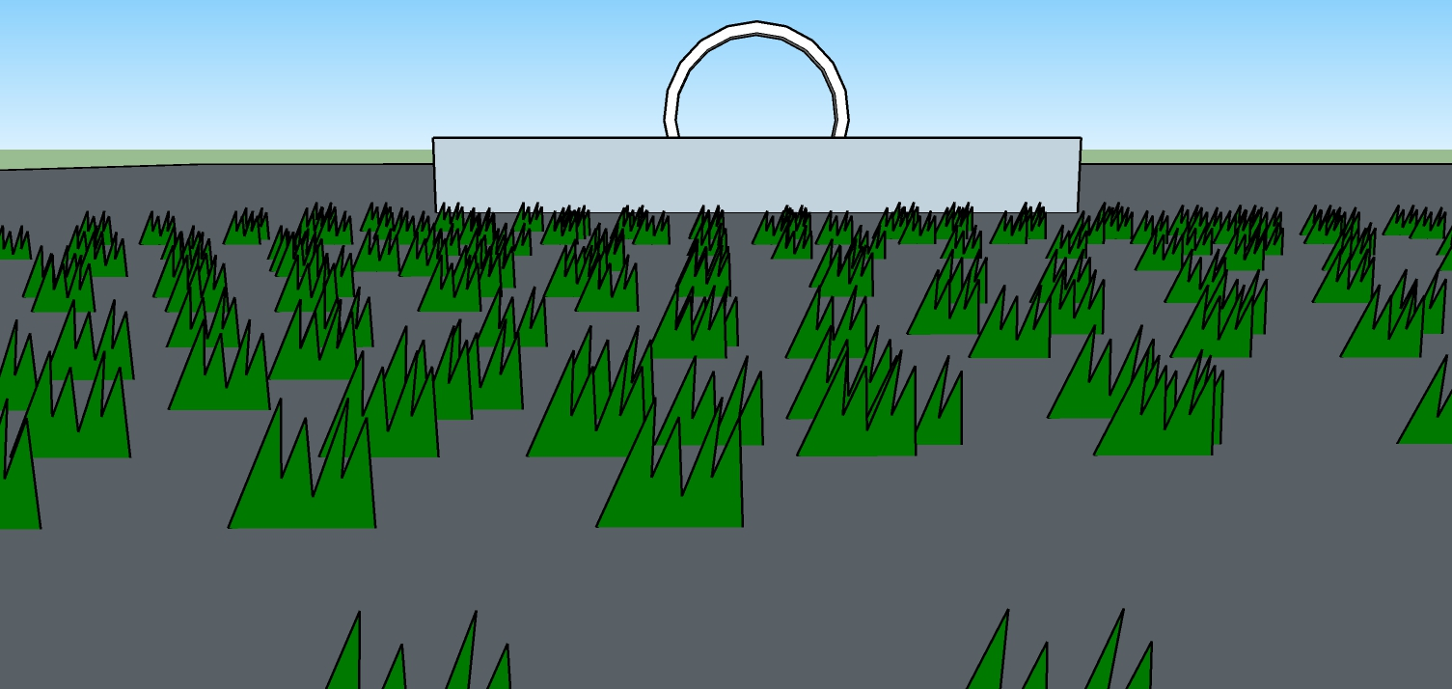
Mock-Up

Slide 8
Idea 3 - Skyscraper

Slide 9
Layout and Concept
A flat plane as ground
Cuboids as floors
Rectangles as windows

Slide 10
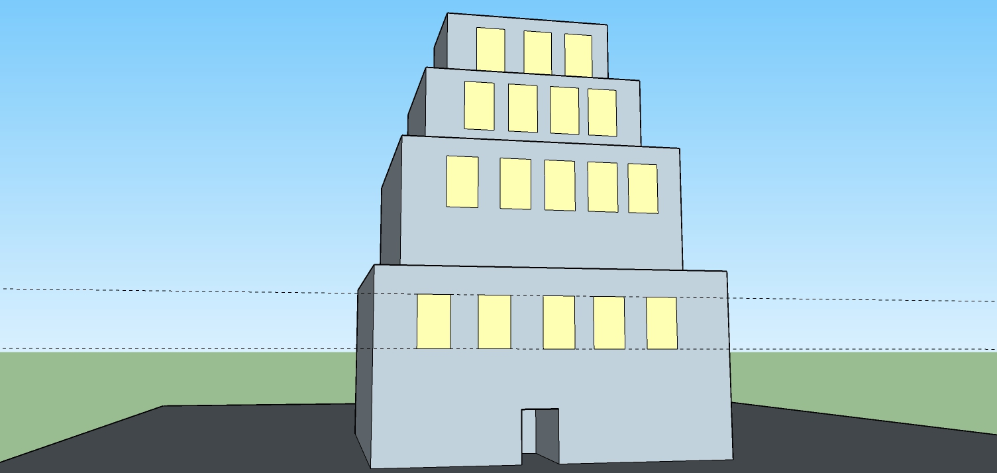
Mock-Up

